Slide 1

Convolutional Neural Networks
1
3
CNNs! No not that CNN.

Slide 2
13.1
What are CNNs?

Slide 3
Convolutional Neural Network (CNN)
A CNN is a type of deep learning neural network model primarily used in processing data with grid-like topology (e.g., images)
Really effective in image recognition and classification tasks
Structure: Composed of layers that automatically and adaptively learn spatial hierarchies of features from input images
13.1. What are CNNs?

Slide 4
Applications of CNN
Image and Video Recognition
Image Analysis & Classification
Medical Image Analysis
Self-Driving Cars
13.1. What are CNNs?

Slide 5
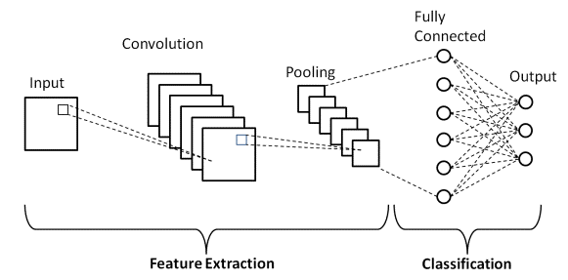
Understanding CNN Architecture
13.1. What are CNNs?

Slide 6
CNN Architecture Step-by-step
Input Layer
Receives the raw pixel values of the image. Typically, images are converted into a 3D array format (height x width x color channels).
Convolutional Layer
Applies a number of filters to the input to create feature maps. Identifies features like edges, textures, etc
13.1. What are CNNs?

Slide 7
CNN Architecture Step-by-step
Activation Layer (Rectified Linear Activation)
Introduces non-linearity to the system. Helps the network learn complex patterns.
Pooling Layer
Reduces the spatial size of the input volume for the next convolutional layer
13.1. What are CNNs?

Slide 8
CNN Architecture Step-by-step
Fully Connected Layer
After several convolutional and pooling layers, the high-level reasoning is done via fully connected layers.
Output Layer
Produces the final output, e.g. softmax for multi-class classification
13.1. What are CNNs?

Slide 9
Key Characteristics of CNNs
Parameter Sharing: Reduces the number of parameters, enabling the network to be deeper with fewer parameters
Local Connectivity: Focusing on local regions helps in capturing spatial hierarchies
Depth: Deeper layers capturing more complex features
13.1. What are CNNs?

Slide 10
13.2
Working with Image Data.

Slide 11
Common Image Preprocessing tools
Often when working with image datasets, the data will require to be preprocessed, similar to previously shown .csv files or text copora
To preprocess images there are certain common tools people often use
13.2. Working with Image Data.

Slide 12
Common Image Preprocessing tools
Resizing: Adjusting the dimensions of the image to match the input size required by the CNN.
Rescaling: Adjusting the pixel values (e.g., dividing by 255) to bring them into a similar scale, typically 0 to
Cropping: Removing parts of the image that are less relevant or to focus on a specific region
13.2. Working with Image Data.

Slide 13
Common Image Preprocessing tools
Padding: Adding extra pixels around the image, often used to maintain aspect ratio after resizing
Color Space Conversion: Adjusting the color format (e.g., from RGB to grayscale) to reduce complexity or meet model requirements
13.2. Working with Image Data.

Slide 14
Modifying Dataset for Broader Representation
If a model learns the representation of a pineaple only from its side view, it won’t be able to detect one when its upside down
To prevent such scenarios, we modify existing image datasets so our model can detect them no matter which orientation they are in
13.2. Working with Image Data.

Slide 15
Modifying Dataset for Broader Representation
Data Augmentation:
Includes rotation, translation, zooming, flipping, etc.
Creates a more diverse set of training images, helping the model generalize better.
Synthetic Data Generation
Creating new, artificial images using various algorithms
13.2. Working with Image Data.

Slide 16
Modifying Dataset for Broader Representation
Class Balancing:
Augmenting underrepresented classes or undersampling overrepresented ones.
Incorporating Diverse Scenarios
Ensuring the dataset includes a wide range of scenarios and conditions (e.g., different lighting, backgrounds)
13.2. Working with Image Data.

Slide 17
END.

